Slide 1

Tote Store
Better tag line

Slide 2
Something that makes sense
Better description less text

Slide 3
Merge w/ prev. slide
Sellers gain single-point access to the growing mobile marketplace.
Apps gain a revenue stream without overhead.
Users gain a mobile-first shopping experience in the apps they use and trust.

Slide 4


Team
Long time friends and co-workers, Carlos and Andy have worked in fast-paced startups from coast-to-coast and are now dropping everything to bring Tote to the booming world of mCommerce. INSERT PICTURES
Carlos — Entrepreneur and tech enthusiast, CMU alum. Ex-Uber Engineer focused on inventory management and logistics on the first versions of UberEATS and UberRUSH.
Andy — Serial entrepreneur, Rice alum. Taken multiple products from idea to market, 3D Systems experience creating detailed, beautiful, customer-first products.

Slide 5
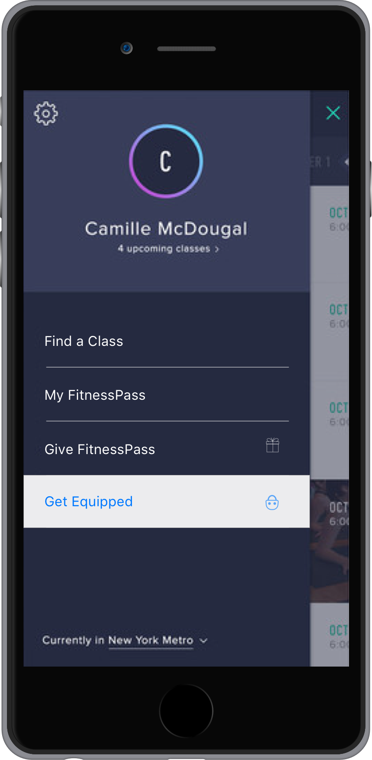
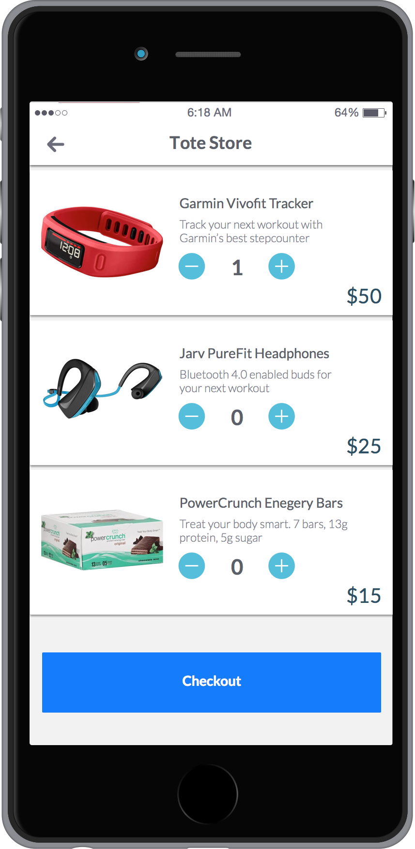
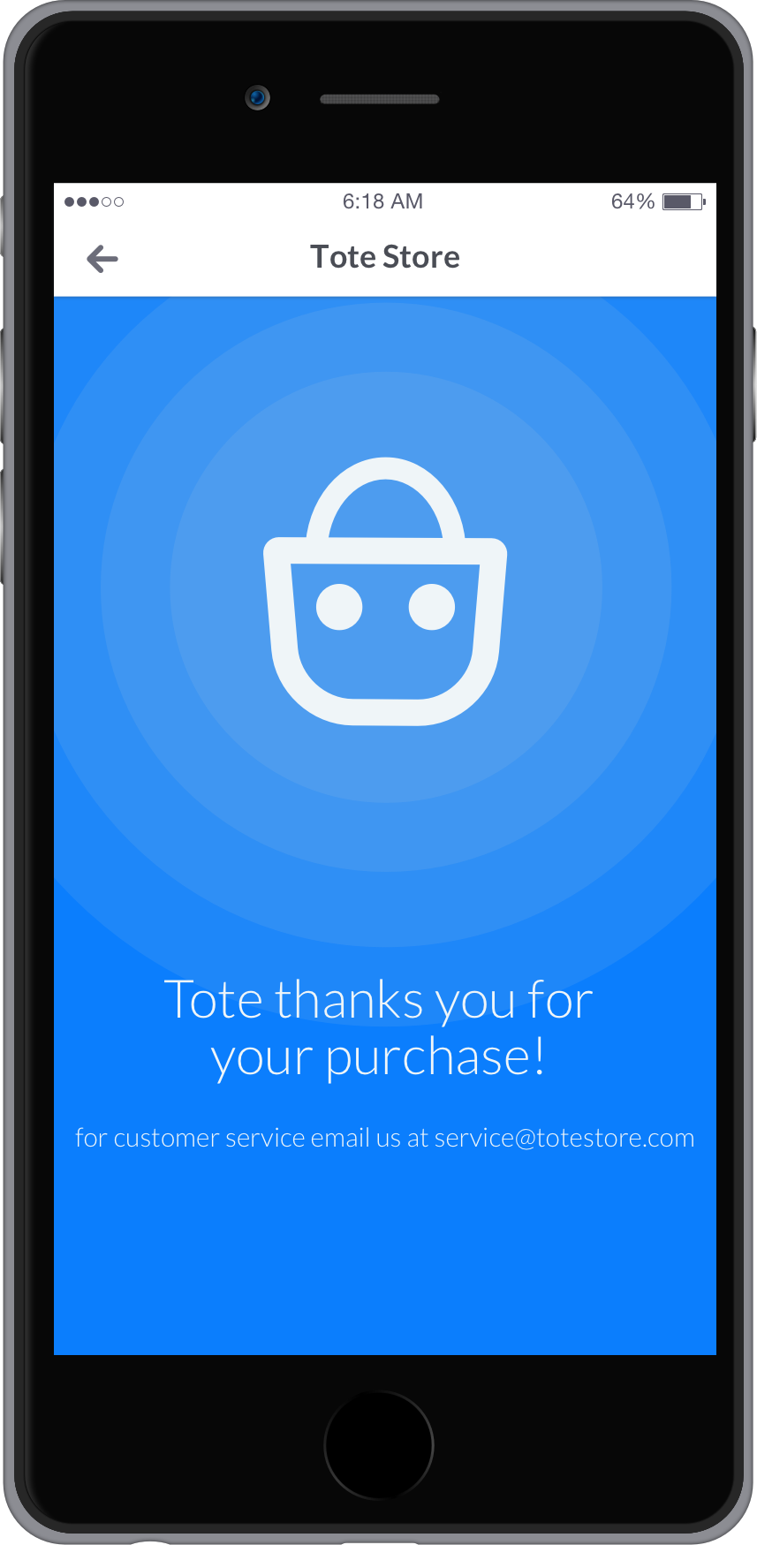
Introducing Tote: a platform for easy-to-implement, mobile stores— as a service.

Slide 6
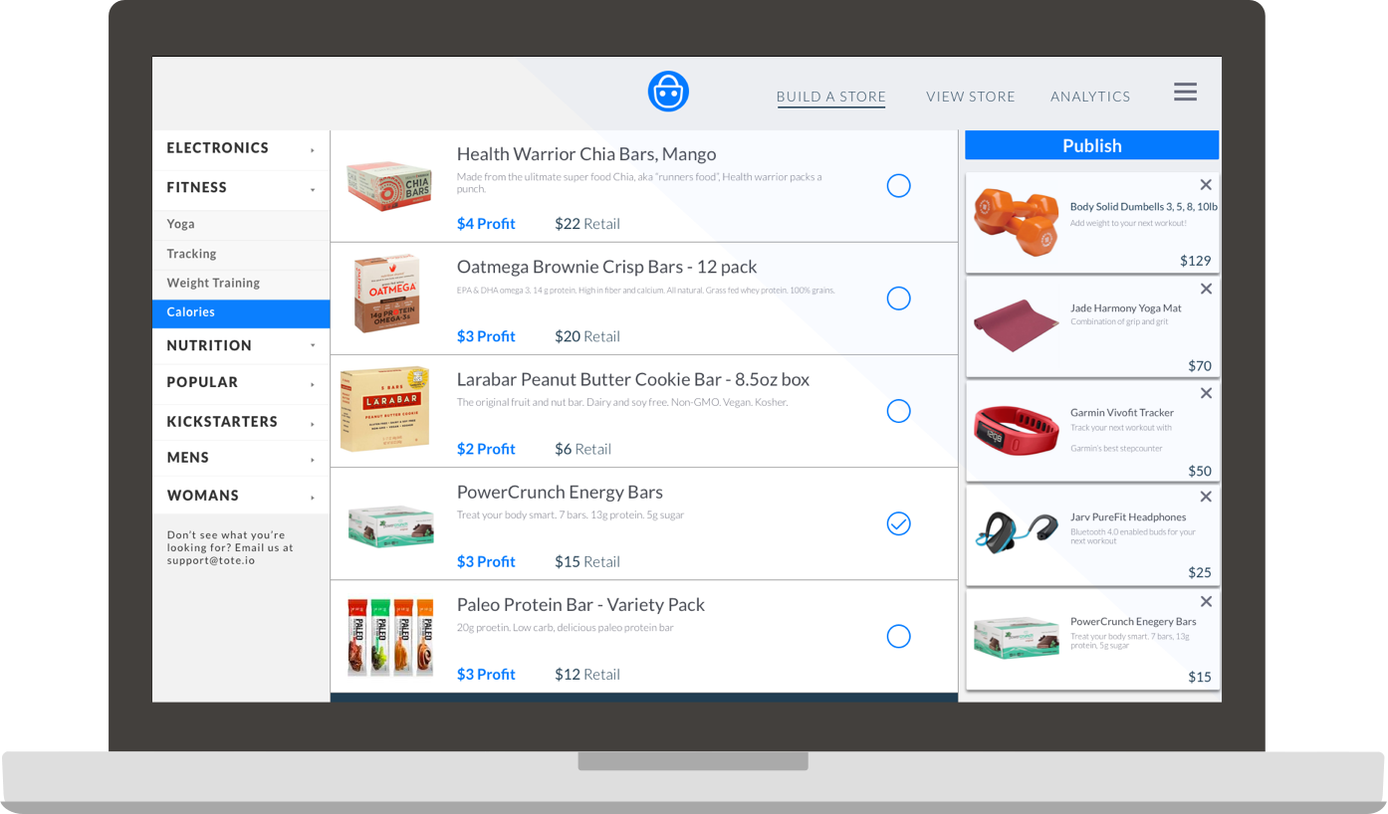
Apps can create, update and embed stores in minutes

Slide 7
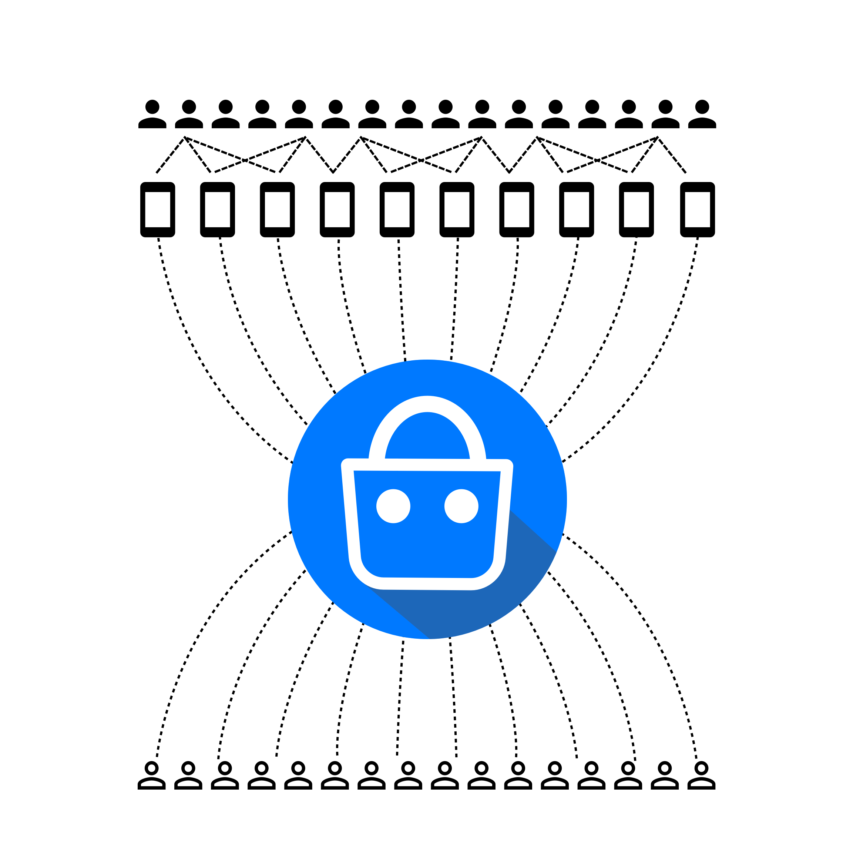
Behind the scenes, Tote powers a logistics network connecting sellers and customers across apps.
Users
Apps
Store Generation
Inventory Management
Shipping Logistics
User Behavior Tracking
Analytics
Customer Service Portal
Sellers

Slide 8
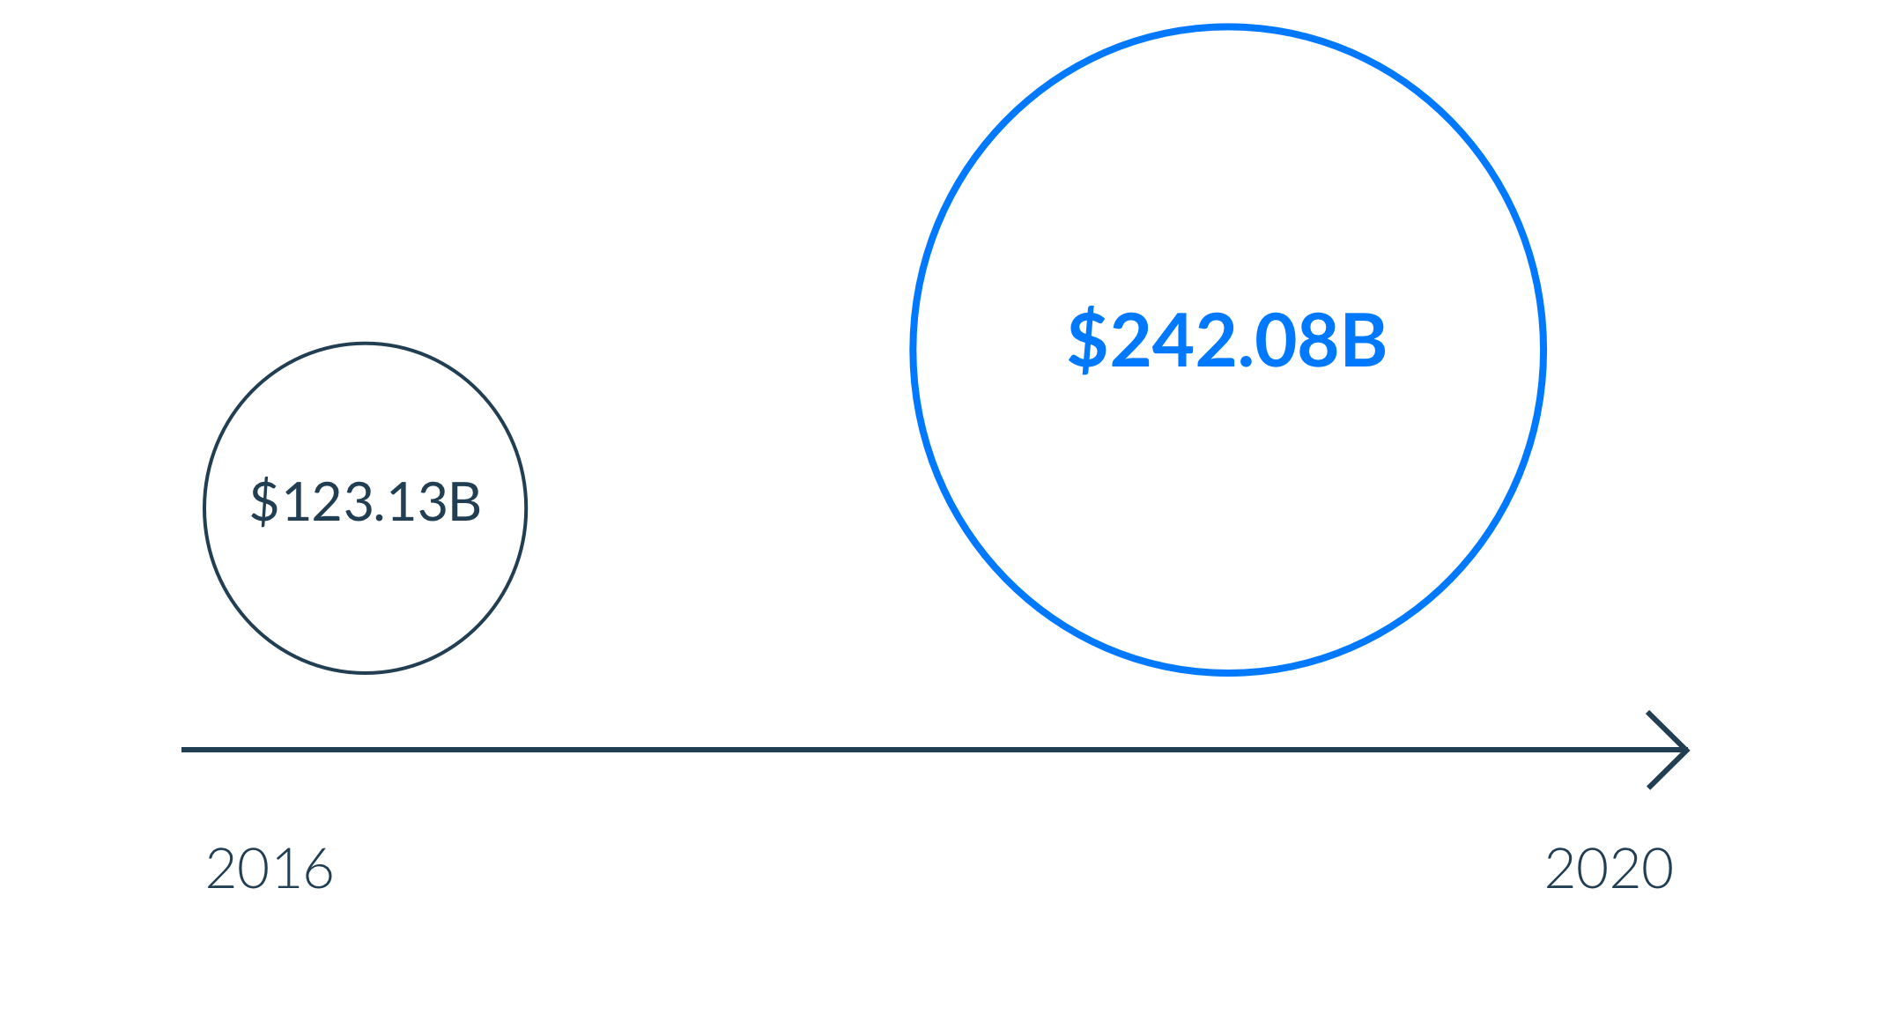
mCommerce Market
Source: eMarketer, Feb 2016

Slide 9
Unit Economics
10% App / 10% Tote / 80% Seller
Example: Zynga 2M users, 2% conv. $2M / year for 10 minutes of work

Slide 10
Network effects. How we stay two steps ahead. Machine learning and user optimization gained by being across apps.
Target mobile ads
Enhance targeted mobile ads with user behavior data ($64B Market)
Membership
Tier
Cross-app rewards for paid members

Slide 11
Join Us!
700k Seed
4 Person Team
12 month runway
MVP + 10 affiliate Apps, 500,000 affiliate app users, $185K revenue

